Slide 1


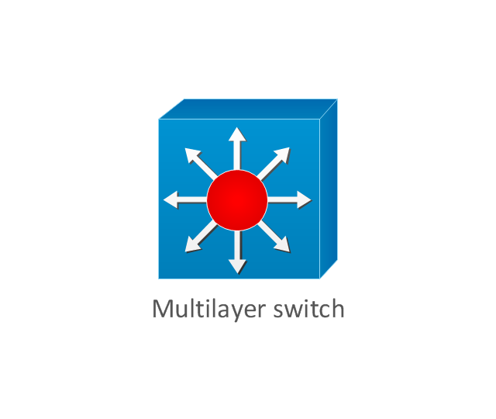
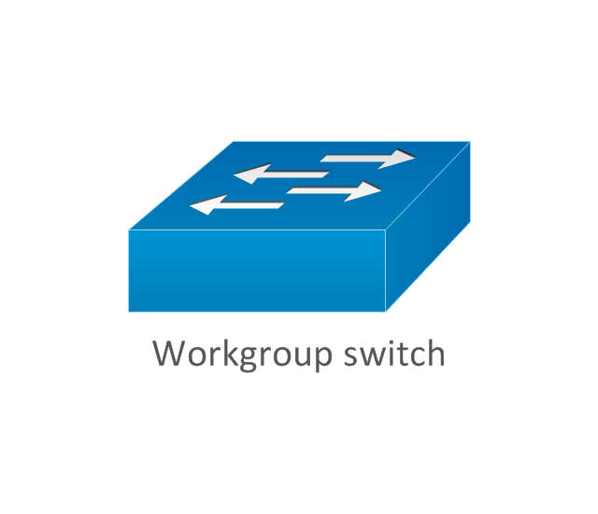
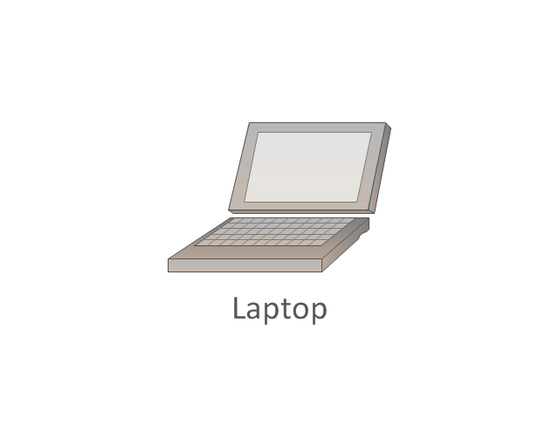
Main-Router
Branch-Router
Cloud
Main-Mux-Switch
Branch-MUX-Switch
------------
-----------

